Slide 1

Hospital Appointment Data Pipeline
Team No. :- 12
2420030014 :- V.Sanjay
2420030368 :- P.Rahul
2420030573 :- M.Aasrith
Under the Guidance of :-
Dr.N.Shirisha,Associate Professor
Department of Computer Science

Slide 2
Abstract
The Hospital Appointment Data Pipeline is a data-driven solution designed to organize, process, and analyze hospital appointment records. The system collects appointment records from structured sources such as CSV or Excel files and processes them through an ETL pipeline using Python. The data is cleaned, transformed, and stored in a structured MySQL database for efficient analysis. SQL-based analytics are used to calculate appointment statistics and identify patient, department-wise, doctor-wise, and monthly appointment patterns. Reports and visualizations provide clear insights into appointment metrics and trends. Appointment trends can support better hospital monitoring and decision-making. The proposed system demonstrates the fundamental stages of data engineering from data ingestion and cleaning to storage and analysis.

Slide 3
Introduction
Hospital appointments are an important part of healthcare service management. Appointment records are often maintained across different systems or files, making data cleaning, storage, and analysis difficult. Raw appointment records may contain missing or duplicate entries and can be time-consuming to process. There is a need for a simple data-driven system that can collect, process, and analyze appointment data. Our project uses Data Engineering techniques to transform raw appointment data into meaningful insights. The system helps monitor appointment patterns, identify cancellations and no-shows, and support efficient hospital record management.

Slide 4
Objectives
To collect hospital appointment data from structured sources such as CSV or Excel files.
To clean and transform raw appointment data using Python.
To remove duplicate records and handle missing or inconsistent values.
To store the processed data in a structured NoSQL database.
To analyze appointment patterns using SQL queries.
To identify completed, cancelled, and no-show appointments.
To generate useful reports and visualizations for hospital staff and administrators.

Slide 5
Literature Survey
No. | Paper Title & Year | Authors | Drawbacks / Limitations | What It Contributes to Our Project | Link
1 | Outpatient Scheduling in Health Care: A Review of Literature – 2003 | Cayirli & Veral | Reviews many scheduling models, but most solutions are situation-specific and do not provide a practical data-processing pipeline. | Helps identify important appointment factors such as waiting time, demand, capacity and scheduling patterns that our cleaned appointment data can be used to analyze. | https://doi.org/10.1111/j.1937-5956.2003.tb00218.x
2 | The Effectiveness of Outpatient Appointment Reminder Systems in Reducing No-Show Rates – 2010 | Parikh et al. | Focuses mainly on reminder interventions and does not implement an automated data engineering workflow. | Shows the importance of tracking appointment status, waiting time and patient attendance, which our pipeline organizes for analysis. | https://doi.org/10.1016/j.amjmed.2009.11.022
3 | Methods and Dimensions of Electronic Health Record Data Quality Assessment – 2013 | Weiskopf & Weng | Focuses on EHR data-quality assessment rather than appointment-specific ETL processing. | Provides data-quality concepts such as completeness, correctness, concordance, plausibility and currency, supporting our cleaning and validation stage. | https://doi.org/10.1136/amiajnl-2011-000681
4 | Outpatient Appointment Systems in Healthcare: A Review of Optimization Studies – 2017 | Ahmadi-Javid, Jalali & Klassen | Concentrates on optimization and decision-support models rather than implementation of a complete data pipeline. | Helps identify strategic, tactical and operational appointment factors that can be derived from our processed hospital records. | https://doi.org/10.1016/j.ejor.2016.06.064
5 | No-shows in Appointment Scheduling – A Systematic Literature Review – 2018 | Dantas et al. | Reviews factors influencing no-shows but does not provide a reusable ETL/database solution for hospital appointment data. | Supports analysis of no-show patterns, lead time and previous appointment behavior using structured appointment records. | https://doi.org/10.1016/j.healthpol.2018.02.002

Slide 6
Literature Survey
No. | Paper Title & Year | Authors | Drawbacks / Limitations | What It Contributes to Our Project | Link
6 | Patient No-Show Prediction: A Systematic Literature Review – 2020 | Zapata et al. | Concentrates mainly on predictive modelling; data preparation and pipeline design are secondary aspects of the study. | Supports the need for structured appointment data, status-based analysis and properly prepared features before applying prediction techniques. | https://doi.org/10.3390/e22060675
7 | A Harmonized Data Quality Assessment Terminology and Framework for the Secondary Use of EHR Data – 2016 | Kahn et al. | Provides a general framework and requires adaptation to specific appointment datasets and workflows. | Provides a systematic basis for checking data completeness, conformance, plausibility and quality during our ETL process. | https://doi.org/10.13063/2327-9214.1244
8 | ETL Processes for Integrating Healthcare Data – Tools and Architecture Patterns – 2022 | Cheng et al. | Compares healthcare ETL tools and architecture patterns; the examples are broader than hospital appointment analytics. | Directly supports our Data Ingestion → Transformation → Storage architecture for processing healthcare appointment data. | https://doi.org/10.3233/SHTI220974
9 | No-Show in Medical Appointments with Machine Learning Techniques: A Systematic Literature Review – 2022 | Salazar et al. | Focuses primarily on machine-learning-based no-show prediction; practical integration with hospital data systems remains limited. | Identifies useful appointment attributes such as patient age, previous no-shows and lead time, which can be derived from our cleaned dataset. | https://doi.org/10.3390/info13110507
10 | Predicting Patient No-Shows Using Machine Learning: A Comprehensive Review and Future Research Agenda – 2025 | Toffaha et al. | Reviews machine-learning research and highlights gaps in data collection, preprocessing and real-world implementation. | Reinforces the importance of reliable data preparation, temporal features and implementation-ready datasets for future predictive analytics. | https://doi.org/10.1016/j.ibmed.2025.100229

Slide 7
Hospital Appointment Data Pipeline Architecture
1. Data Ingestion Layer (Raw Inputs)
Source Data: Raw, unorganized hospital files (CSV/JSON format)
Contents: Messy records of appointment bookings, patient details, and doctor schedules
2. Data Transformation Layer (The Processing Engine)
Data Cleaning: Python/SQL scripts automatically drop duplicate records and handle missing (null) values
Standardisation: Converts conflicting date/time formats into a single, uniform standard
Feature Engineering: Automatically calculates the Lead Time (days between booking date and appointment date)
3. Storage Layer (The Clean Database)
Structured Storage: Cleaned data is saved into a NoSQL database (MongoDB) instead of a relational store
Schema Design: Data is organized into collections — Patients, Doctors, and Appointments — instead of relational tables, using embedded/document structures for fast, flexible querying (e.g., a Patient document can embed their recent appointment history directly, reducing joins)
4. Analytical Output Layer (The Final View)
Status Classification: Organizes records into indexed status fields — Completed, Cancelled, No-Show (MongoDB supports single-field and compound indexes on these directly within documents)
Business Intelligence Ready: Delivers clean, structured datasets ready for tracking monthly trends, department vacancies, and doctor cancellation rates

Slide 8
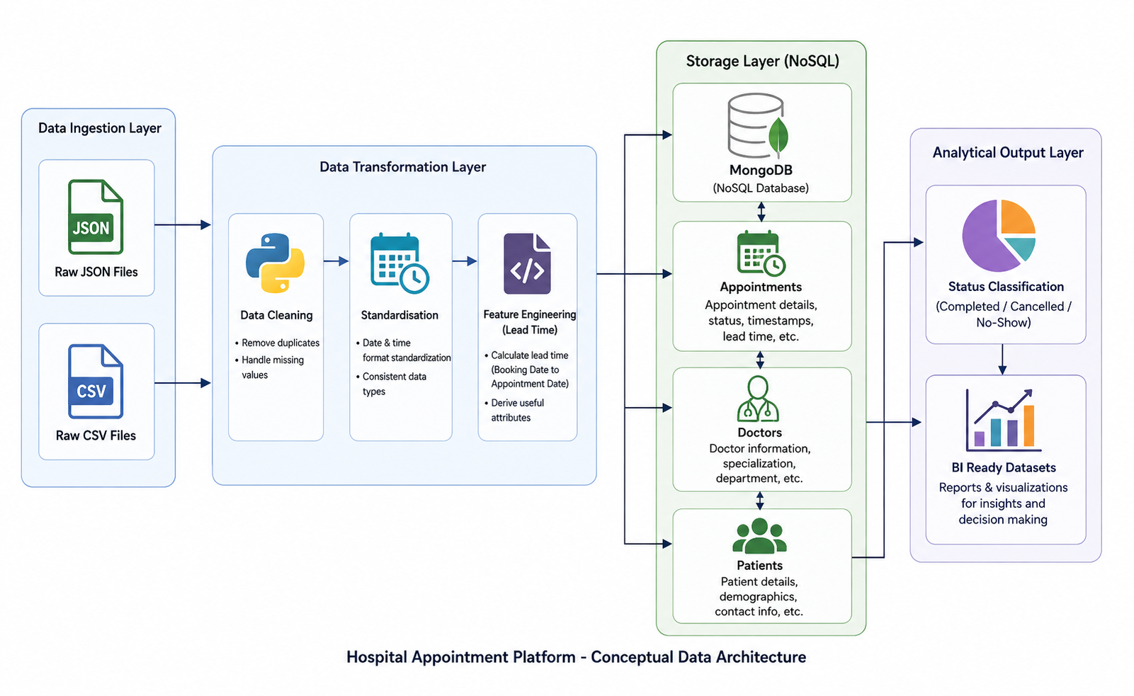

Slide 9
THANK YOU

